Slide 1
Recap of Linear Regression and a discussion on
Durbin Watson Statistic

Slide 2
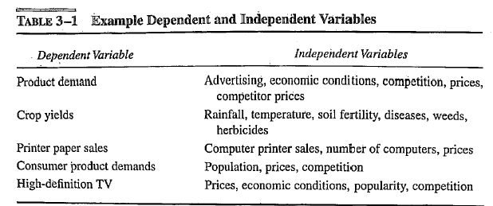
Dependent Vs Independent variables

Slide 3
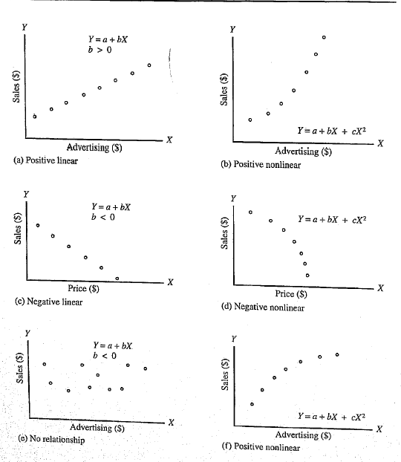
Relationships – dependent Vs independent variables

Slide 4
Simple Linear Regression
Observation: y
^
Prediction: y
Dependent variable
Zero
Independent variable (x)
The function will make a prediction for each observed data point.
The observation is denoted by y and the prediction is denoted by y.
^

Slide 5
Simple Linear Regression
Prediction error: ε
Observation: y
^
Prediction: y
Zero
For each observation, the variation can be described as:
y = y + ε
Actual = Explained + Error ie. residual
^

Slide 6
Regression
Dependent variable
Independent variable (x)
A least squares regression selects the line with the lowest total sum of squared prediction errors.
This value is called the Sum of Squares of Error, or SSE.

Slide 7
Calculating SSR
Population mean: y
Dependent variable
Independent variable (x)
The Sum of Squares Regression (SSR) is the sum of the squared differences between the prediction for each observation and the population mean.

Slide 8
Regression Formulas
The Total Sum of Squares (SST) is equal to SSR + SSE.
Mathematically,
SSR = ∑ ( y – y ) (measure of explained variation)
SSE = ∑ ( y – y ) (measure of unexplained variation)
SST = SSR + SSE = ∑ ( y – y ) (measure of total variation in y)
^
2
^
2
2

Slide 9
The proportion of total variation (SST) that is explained by the regression (SSR) is known as the Coefficient of Determination, and is often referred to as R .
R-squared = (SSR/ SST) or since SSR = SST -SSE
= [ 1- (SSE/ SST)
The value of R-squared can range between 0 and 1, and
the higher its value the more accurate the regression model is.
It is often referred to as a percentage.
The Coefficient of Determination
R-squared tells us what percent of the prediction error in the y variable is eliminated when we use least-squares regression on the x variable.
As a result, R-squared is also called the coefficient of determination.
R² tells us what percent of the variability in the y variable is accounted for by the regression on the x variable.

Slide 10
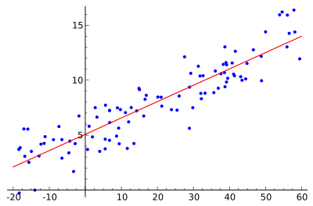

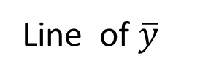

R-squared
Small if good fit
$$R^{2}=1− \frac{\sum{{\left(y_{i}−\hat{y_{i}}\right)}^{2}}}{\sum{{\left(y_{i}−\overline{y}\right)}^{2}}}$$
y
Line of $\hat{y}$
Line of $\overline{y}$
X
Notes:
What R-squared value would you expect under the null hypothesis ?

Slide 11
R-Squared Calculation Example
Assume the following set of (x, y) data points:
(3, 40), (10, 35), (11, 30), (15, 32), (22, 19), (22, 26), (23, 24), (28, 22), (28, 18) and (35, 6).
"line of best fit" equation. This equation, based on the unique date, is an equation that predicts a Y value based on a given X value. In this example, assume the line of best fit is:
y = 0.94x + 43.7
Compute predicted Y values. As an example, the predicted Y value for the first data point is:
y = 0.94(3) + 43.7 = 40.88
The entire set of predicted Y values is: 40.88, 34.3, 33.36, 29.6, 23.02, 23.02, 22.08, 17.38, 17.38 and 10.8.
Take each data point's predicted Y value, subtracts the actual Y value and squares the result. For example, using the first data point:
Error squared = (40.88 - 40) ^ 2 = 0.77
The entire list of error's squared is: 0.77, 0.49, 11.29, 5.76, 16.16, 8.88, 3.69, 21.34, 0.38 and 23.04. The sum of these errors is 91.81. (SSE)
Next, take the predicted Y value and subtract the average actual value, which is 25.2. Using the first data point, this is: (40.88 - 25.2) ^ 2 = 14.8 ^ 2 = 219.04. Sum up all these differences, which in this example, equals 855.6. (SSR)
Lastly, to find the R-squared, take the first sum of errors, divide it by the second sum of errors and subtracts this result from 1. In this example it is:
SST = (SSE + SSR) = (91.81+855.6) =947.41
R-squared = (SSR/ SST) or [ 1- (SSE/ SST) ]. Here [1 - (91.81 /947.71) = 1 - 0.097 = 0.9
Closer it is to 1, the better the model is R-Squared http://www.investopedia.com/terms/r/r-squared.asp#ixzz4n10omMFL

Slide 12
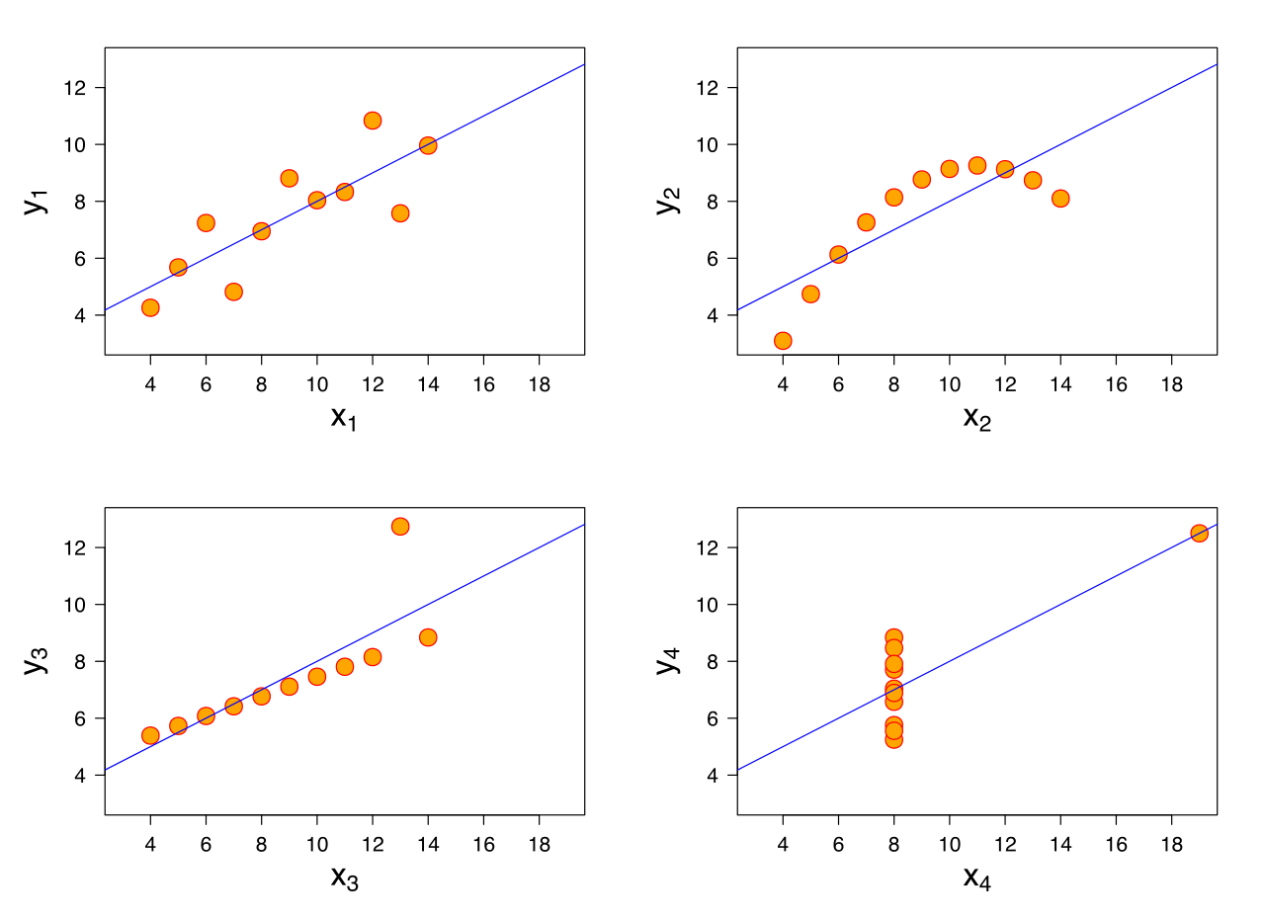
R²-values and P-values
We can always fit a linear model to any dataset, but how do we know if there is a real linear relationship?
Notes:
12

Slide 13
What Is R-squared?
R-squared is a statistical measure of how close the data are to the fitted regression line. It is also known as the coefficient of determination, or the coefficient of multiple determination for multiple regression.
The definition of R-squared; it is the percentage of the response variable variation that is explained by a linear model. Or:
R-squared = Explained variation / Total variation
R-squared is always between 0 and 100%:
0% indicates that the model explains none of the variability of the response data around its mean.
100% indicates that the model explains all the variability of the response data around its mean.
In general, the higher the R-squared, the better the model fits your data. However, there are important conditions for this guideline……

Slide 14
R²-values and P-values
Approach: Use a hypothesis test. The null hypothesis is that there is no linear relationship (β = 0).
Statistic: Some value which should be small under the null hypothesis, and large if the alternate hypothesis is true.
R-squared: a suitable statistic.
.
Notes:
14

Slide 15
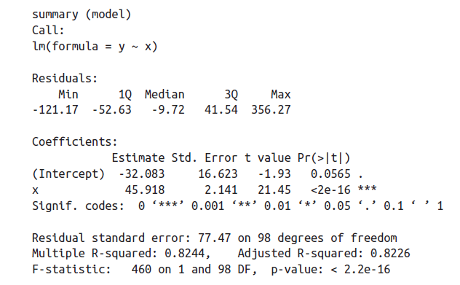
Evaluation Metrics
how confident you would be in these estimates and in your model.
Output of the R function get at the issue of how confident one can be in the estimates:
p-values and R-squared.

Slide 16
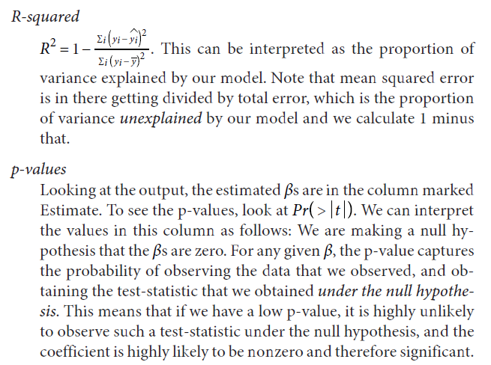

Slide 17

Residuals
linear regression to estimate values of a response variable based on a predictor.
A measure of how far off the estimates are from the actual values…. These differences are called residuals.
A residual is what's left over : the residue, after estimation.
Residuals are the vertical distances of the points from the regression line.
There is one residual for each point in the scatter plot.
residual = Observed value – regression estimate

Slide 18
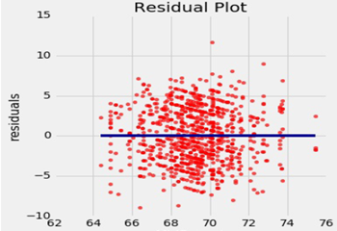
Residuals
A residual plot can be drawn by plotting the residuals against the predictor variable
Notice that the plot appears to be centered around the horizontal line at the level 0 (shown in dark blue).
Notice also that the plot shows no upward or downward trend. …. that this is true of all regressions.

Slide 19
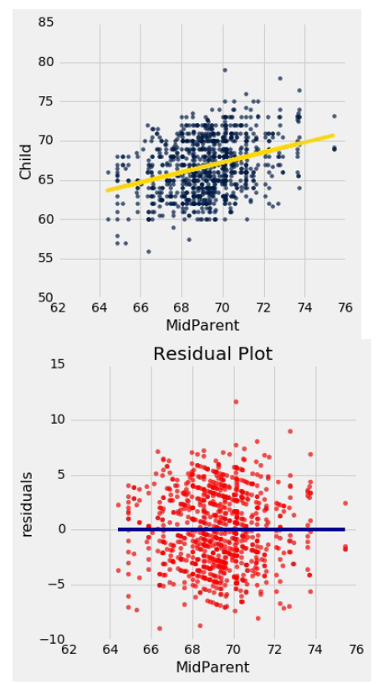
Residuals
This residual plot indicates that linear regression was a reasonable method of estimation.
Notice how the residuals are distributed fairly symmetrically above and below the horizontal line at 0, corresponding to the original scatter plot being roughly symmetrical above and below.
Notice also that the vertical spread of the plot is fairly even across the independent variable axis (x axis).
In other words, the accuracy of the regression appears to be about the same across the observed range of the predictor variable.
The residual plot of a good regression shows no pattern.
The residuals look about the same, above and below the horizontal line at 0, across the range of the predictor variable.

Slide 20
Durbin Watson Statistic

Slide 21
What is The Durbin Watson Test?
The Durbin Watson statistic is a test statistic to detect autocorrelation(also called serial correlation) in the residuals from a regression analysis.
Autocorrelation is the similarity of a time series over successive time intervals.
High autocorrelations can result in very low (i.e., biased) estimates of the true Standard Error of Estimates (SEE)
Therefore it can lead to underestimates of the standard error and can cause you to think predictors are significant when they are not.
The Durbin Watson test looks for a specific type of serial correlation, the AR(1) process.

Slide 22
What is The Durbin Watson Test?
The Durbin Watson statistic is a test statistic to detect autocorrelation(also called serial correlation) in the residuals from a regression analysis.
Autocorrelation is the similarity of a time series over successive time intervals.
High autocorrelations can result in very low (i.e., biased) estimates of the true Standard Error of Estimates (SEE)
Therefore it can lead to underestimates of the standard error and can cause you to think predictors are significant when they are not.
The Durbin Watson test looks for a specific type of serial correlation, the AR(1) process.
The Hypotheses for the Durbin Watson test are:
H₀ = no first order autocorrelation. H₁ = first order correlation exists.
(For a first order correlation, the lag is one time unit).
Assumptions are:
That the errors are normally distributed with a mean of 0.
The errors are stationary.

Slide 23
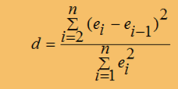
Durbin Watson (DW) statistic
What appears to be a very strong relationship disappear when the autocorrelation in errors is eliminated. Now let us learn to just detect problems with auto correlation. The DW is part of the standard output of most regression programs.
The test statistic is calculated with the formula
The Durbin-Watson statistic will always have a value ranging between 0 and 4:
A value of 2.0 indicates there is no autocorrelation detected in the sample.
Values from 0 to less than 2 point to positive autocorrelation and
Values from 2 to 4 means negative autocorrelation.

Slide 24
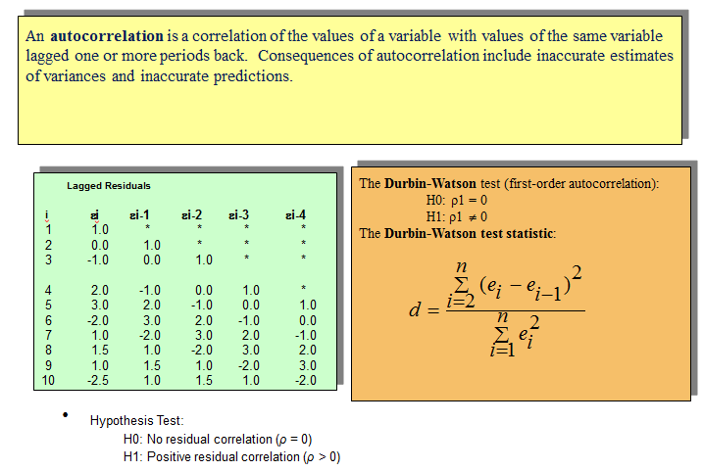
Durbin Watson Test

Slide 25
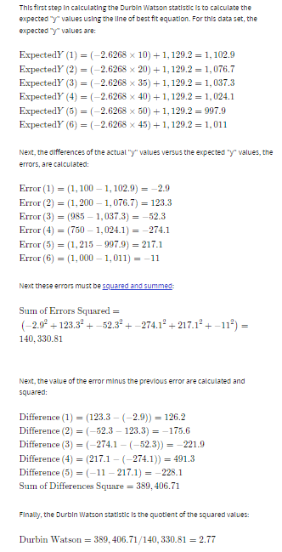
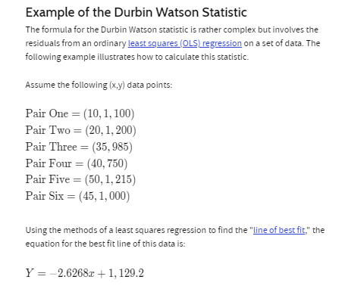

Slide 26
Summary
Regression Formulas
SEE
SEE is Standard Error of Estimate (also Residual standard Error RSE) – measures the dispersion of actual values about fitted values.
SEE ideally should be close to zero.
SEE should be low relative to the variance of Y.
F Value
Measures overall stat sig of the relationship; higher the better
Significance level of F(low value shows dependence of variables.
Durbin-Watson statistic
Checks if the fitted errors(residuals) have temporal pattern left in them.
Should be close to 2.0
If not, then the SEE, F and t-values may not be valid.
Significance Level
Refers to t-statistics of the coefficients -gives the probability that the value could be zero (meaning that their contributions are in fact significant)

